Slide 1
Lec - 1

Slide 2
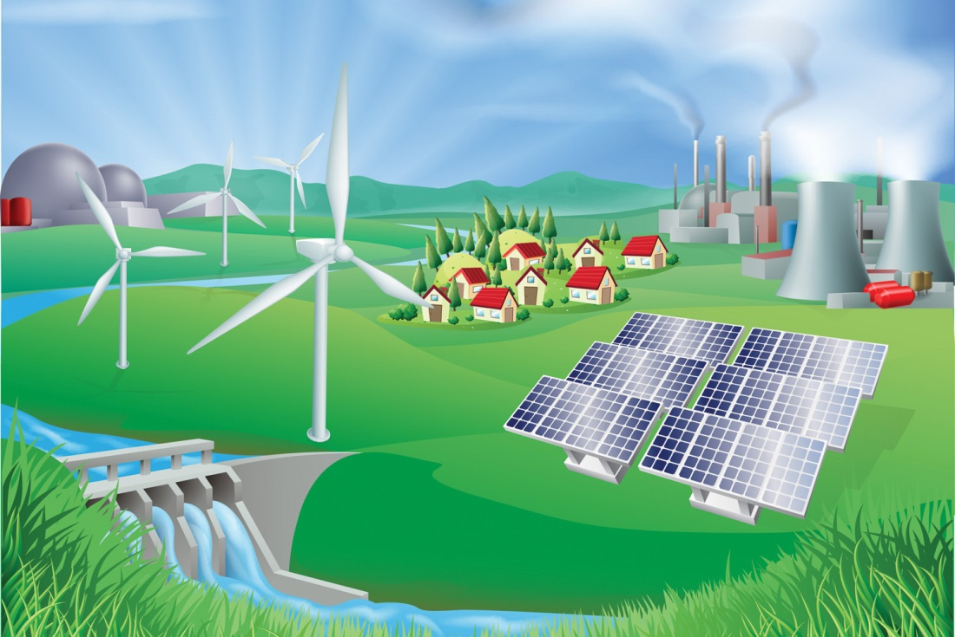
SOURCES OF ENERGY

Slide 3

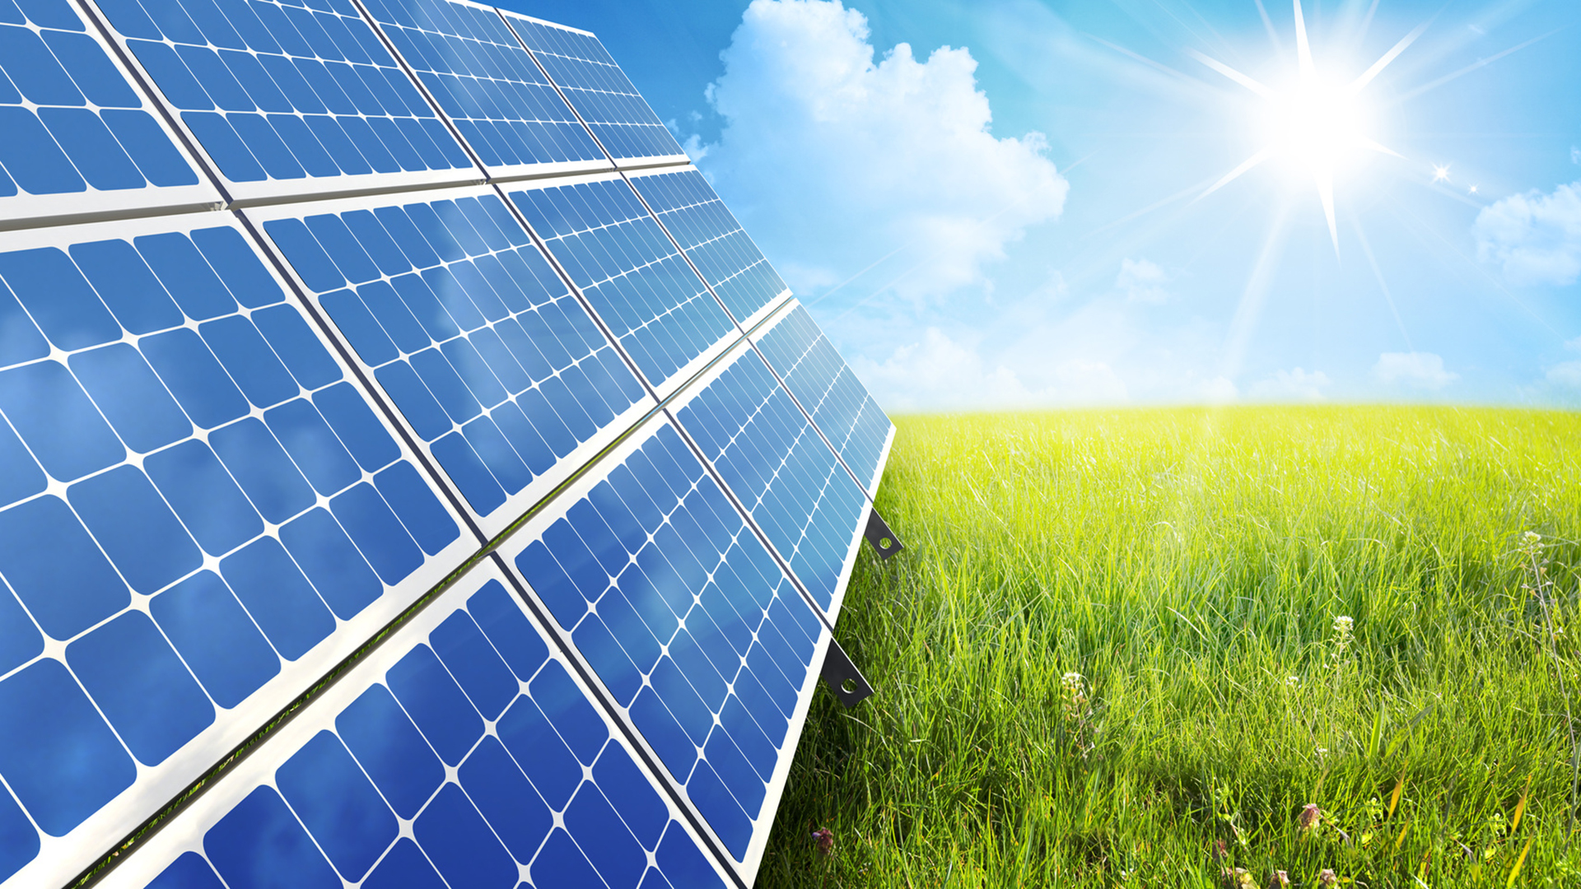
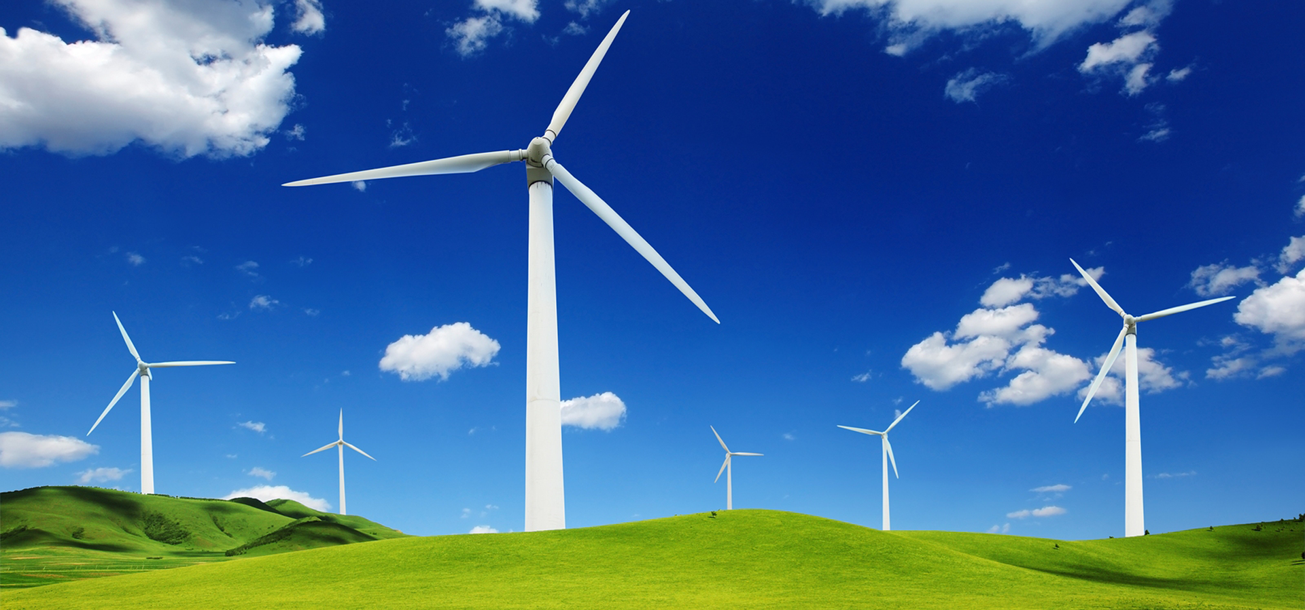




Solar Panel
ENERGY
Wind Mill Farm
Water Heating
A Person Shouting
The energy of a body is its capacity to do work.
There are various forms of energy:
120
100
Solar Energy
Wind Energy
Sound Energy
Heat Energy
80
60
40
20
00
Energy can neither be created nor be destroyed,
It can be changed from one form into another.

Slide 4
ENERGY
The energy of a body is its capacity to do work.
There are various forms of energy:
Solar Energy
Wind Energy
Sound Energy
Heat Energy
Energy can neither be created nor be destroyed,
It can be changed from one form into another.

Slide 5

ENERGY
DEGRADATION
The gradual decrease of useful energy due to radiation loss, friction, etc. is called the degradation of energy.

Slide 6

EXAMPLES OF ENERGY DEGRADATION
1. Light Bulb using electricity
25% OF THE ELECTRICAL
LIGHT ENERGY
MAJOR PART CONVERTS INTO HEAT

Slide 7
EXAMPLES OF ENERGY DEGRADATION
1. Light Bulb using electricity
2. A Running vehicle

Slide 8

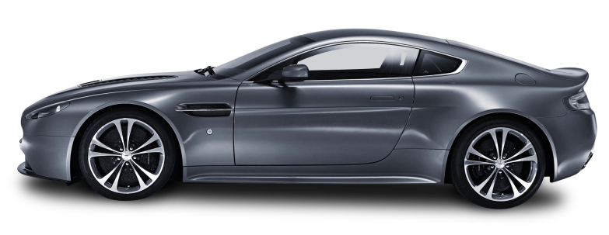
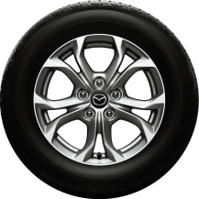
HEAT
MAJOR PART OF ENERGY
FRICTION
SMALL PART OF ENERGY
USED TO RUN VEHICLE
SOUND

Slide 9
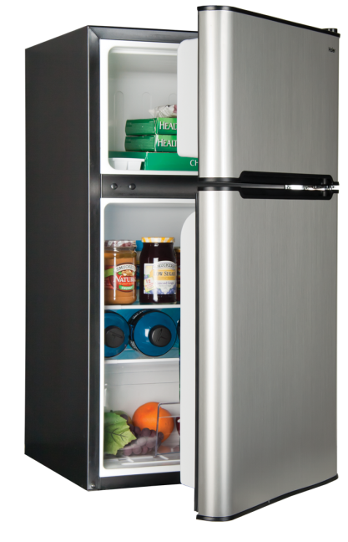

EXAMPLES OF ENERGY DEGRADATION
1. Light Bulb using electricity
2. A Running vehicle
ELECTRICAL ENERGY
3. Electrical appliances running on electricity
HEAT

Slide 10
EXAMPLES OF ENERGY DEGRADATION
1. Light Bulb using electricity
2. A Running vehicle
3. Electrical appliances running on electricity
4. Transmission of electricity from power generating station

Slide 11



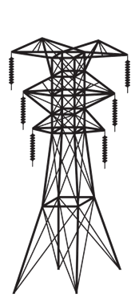


LOSS OF
CHARGE
POWER
GENERATING STATION
LOSS DUE TO
HEAT
HOME

Slide 12
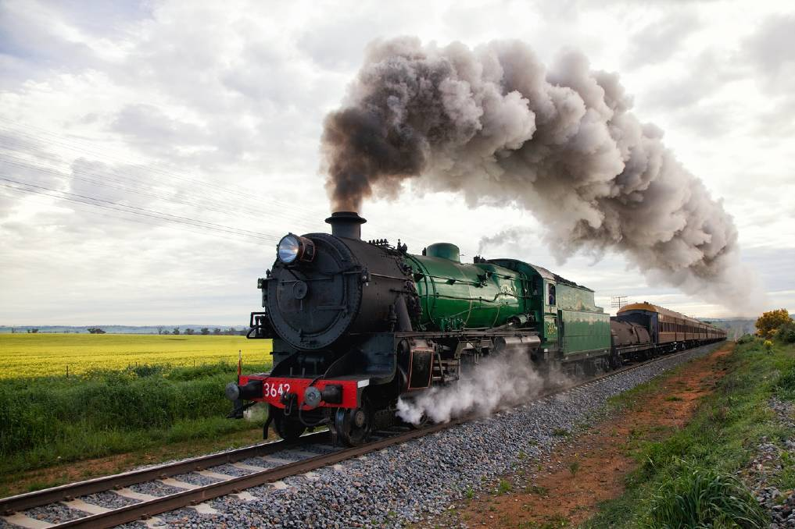
GOOD SOURCE OF ENERGY
Chemical Energy Is Used To Run The Trains
The source of Energy useful to us is called as a Good Source of Energy.
CHARACTERISTICS OF
GOOD SOURCE OF ENERGY
1. Large amount of work per unit volume or mass
2. Easily accessible
(higher calorific value)
Amount of heat energy produce on complete combustion of 1 kg of fuel
3. Easy to store and transport
4. Economical

Slide 13


Q.
What are the qualities of an ideal source of energy?
If you could use any source of energy for heating your food, which one would you use and why?
Q.
Ans:
Natural gas can be used for heating and cooking food as it is a clean source of energy.
It has high calorific value also it does not produce a large amount of smoke on burning.
It is easy to use and easy to transport.

Slide 14
Q.
What is a good fuel?
Ans:
Characteristics of an ideal fuel are :
High calorific value.
Burn without creating pollution.
Proper ignition temperature.
Economical and easily available.
It should be easy to handle, safe to transport and convenient to store.
Burn smoothly at a steady rate.

Slide 15
Hydrogen has been used as a rocket fuel. Would you consider it a cleaner fuel than CNG ? Why or why not ?
Q.
Ans:
Hydrogen is a cleaner fuel than CNG. This is because burning of hydrogen produces only water, which is totally harmless.
On the other hand, burning of CNG produces carbon dioxide gas and water.
This carbon dioxide can produce greenhouse effect in the atmosphere and lead to the excessive heating of the environment in the long run.

Slide 16
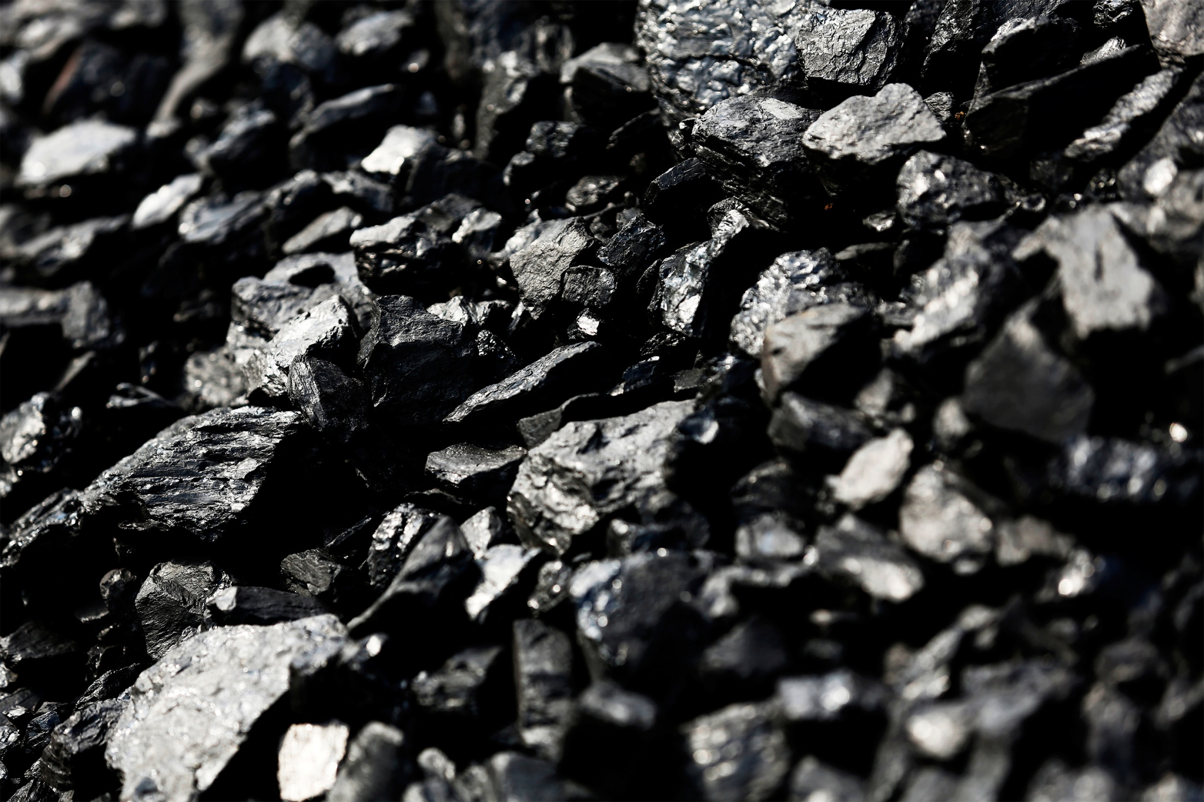
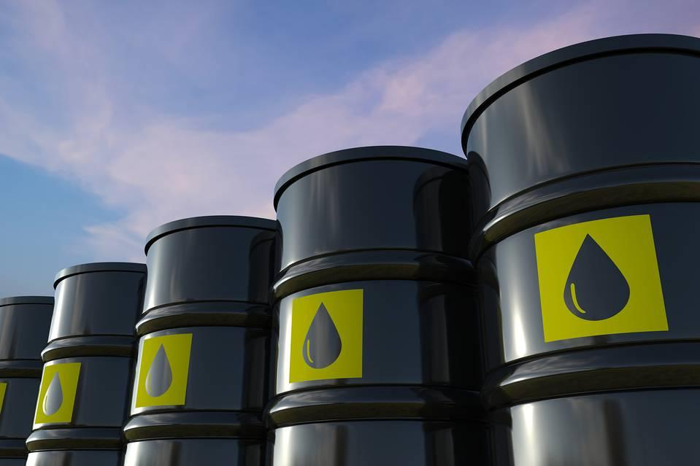
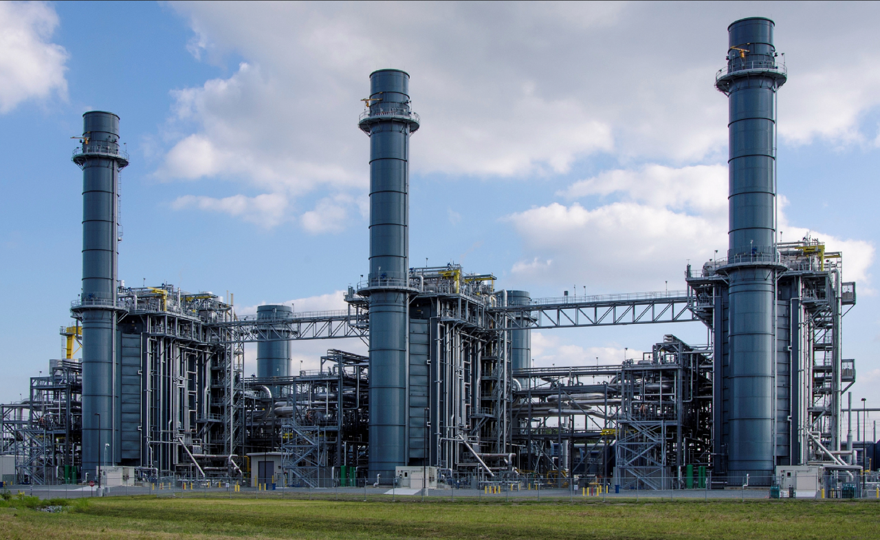
PETROLEUM
COAL
Non-renewable or
Conventional sources of energy
NATURAL GAS
The sources of energy which have accumulated in nature over a very long period and cannot be quickly replaced when exhausted, are called the non-renewable or conventional.

Slide 17

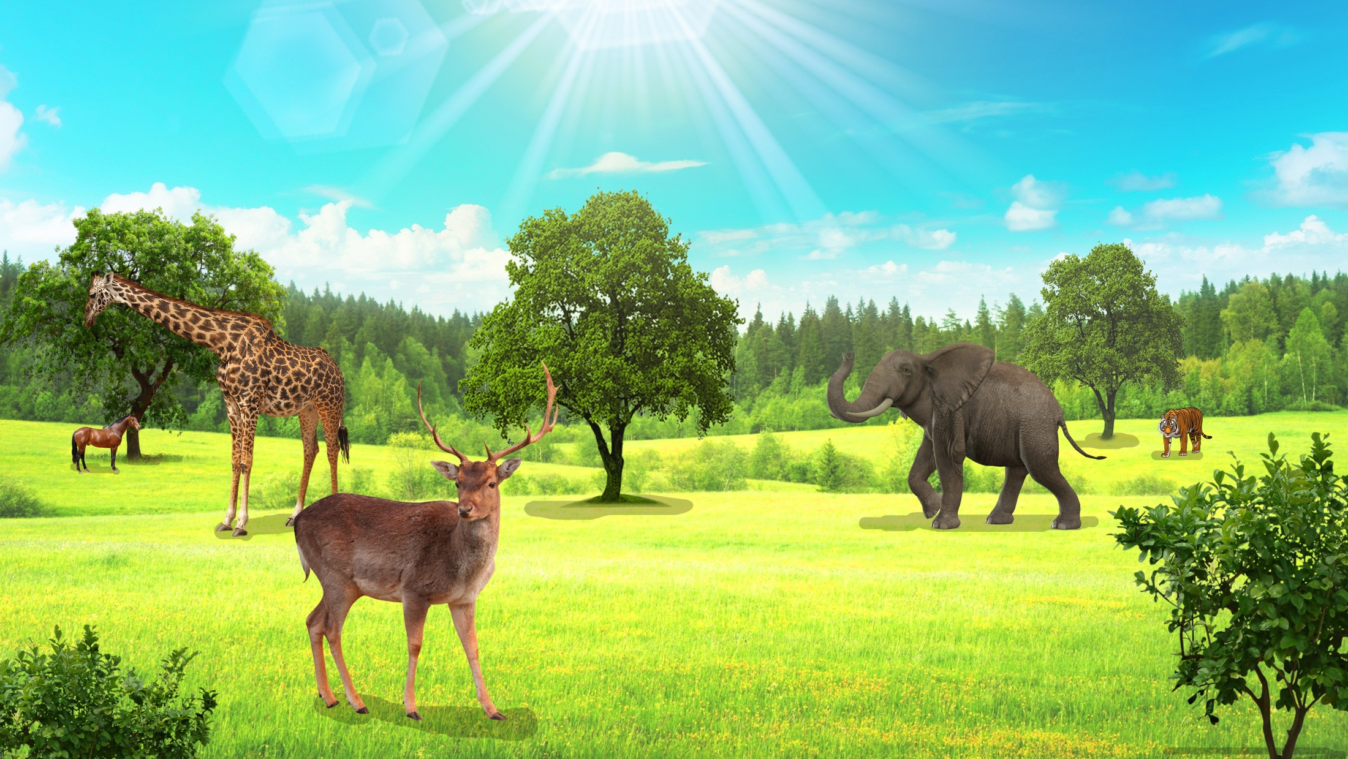
Solar Energy gets stored in the Plants and Animals in the form of CHEMICAL ENERGY

Slide 18
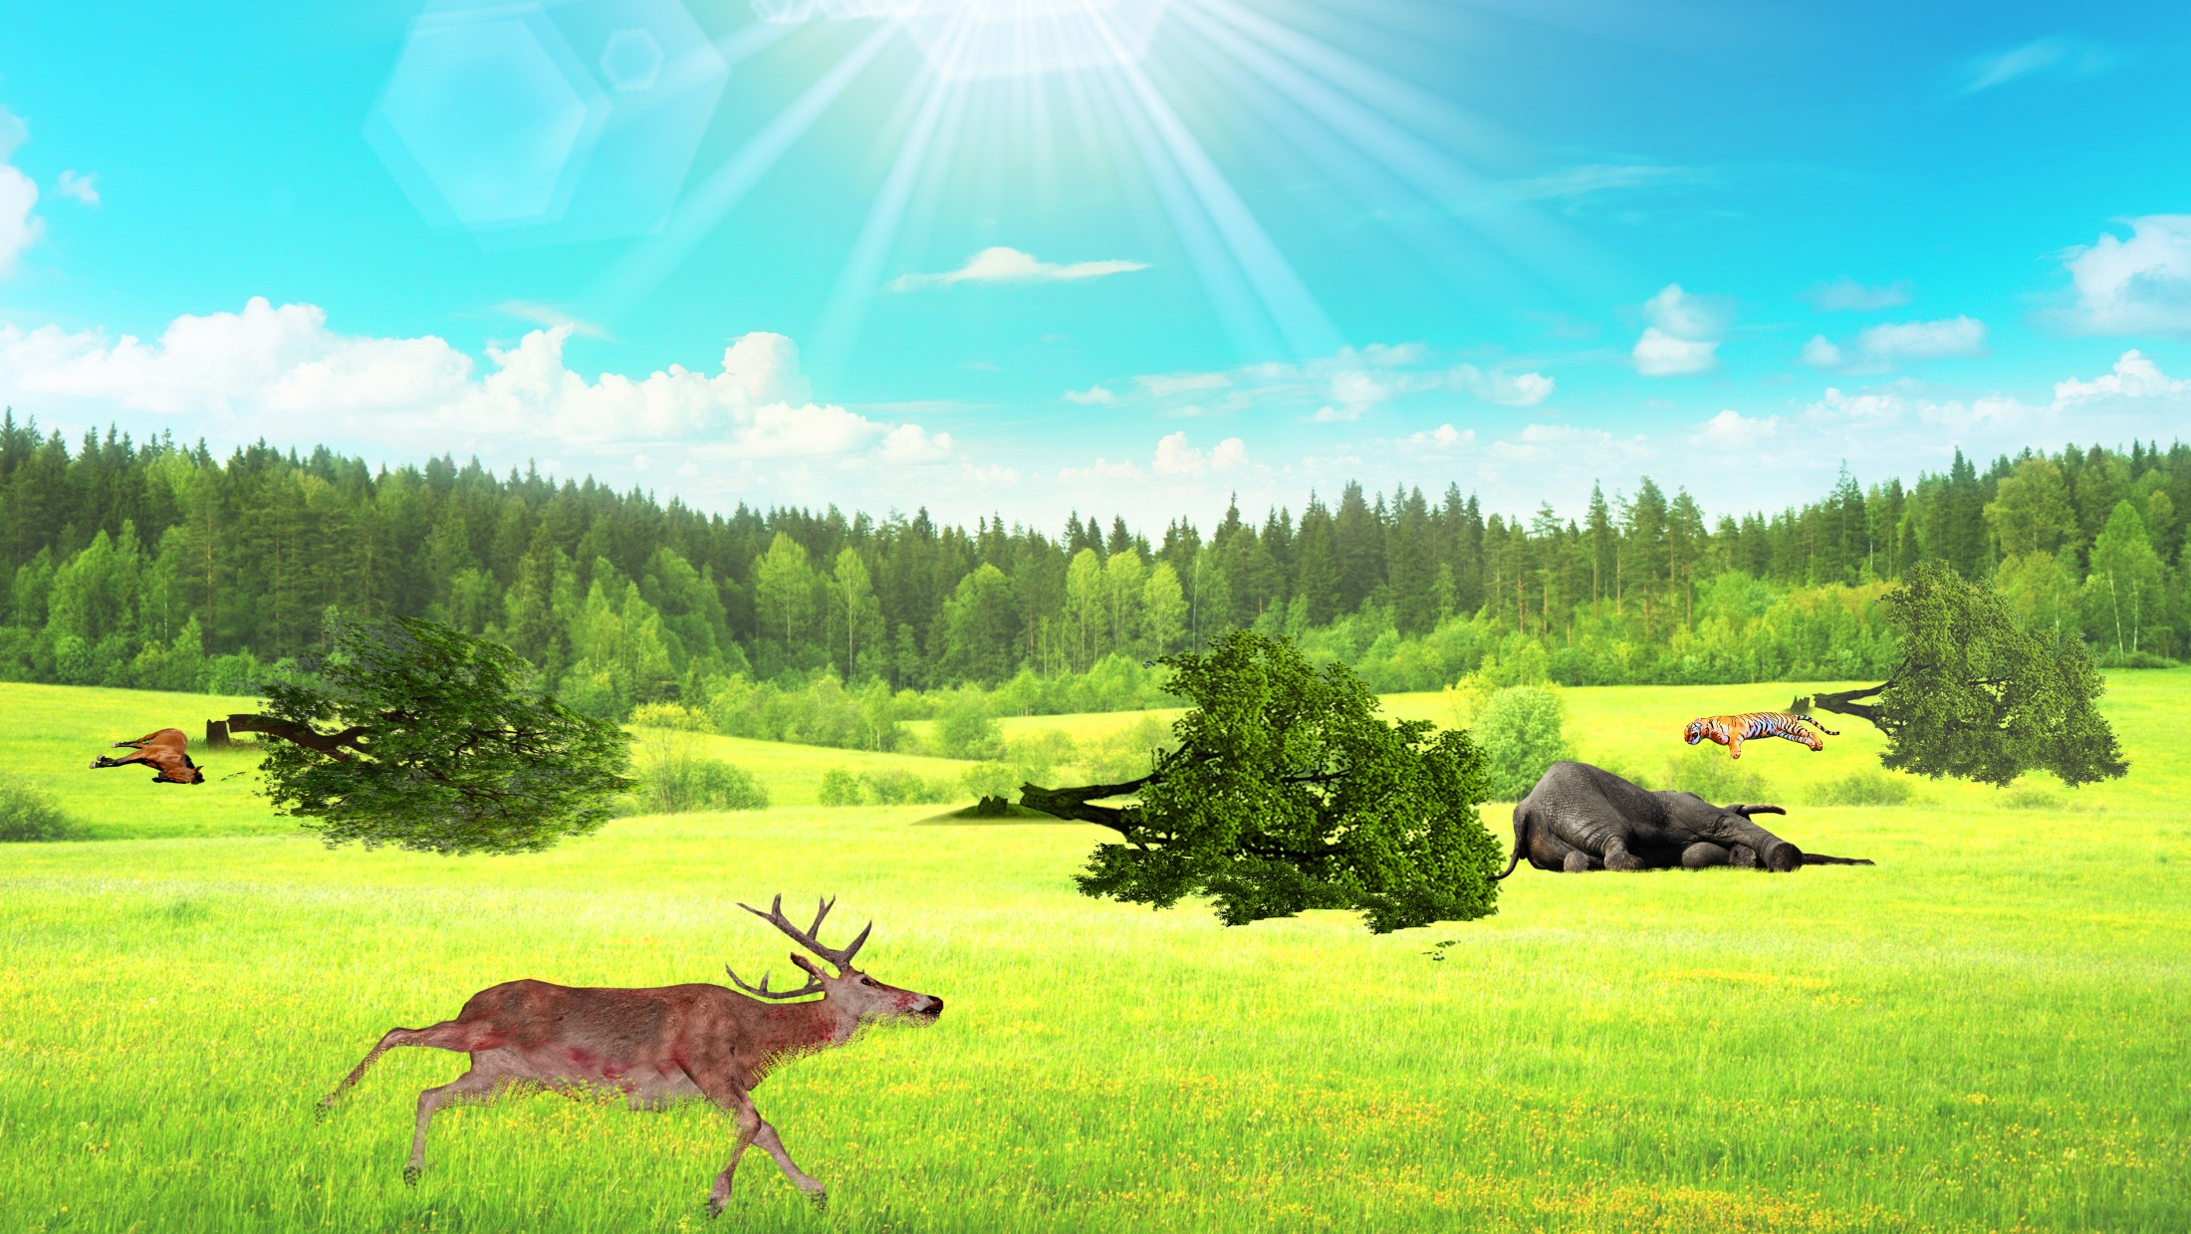

Slide 19
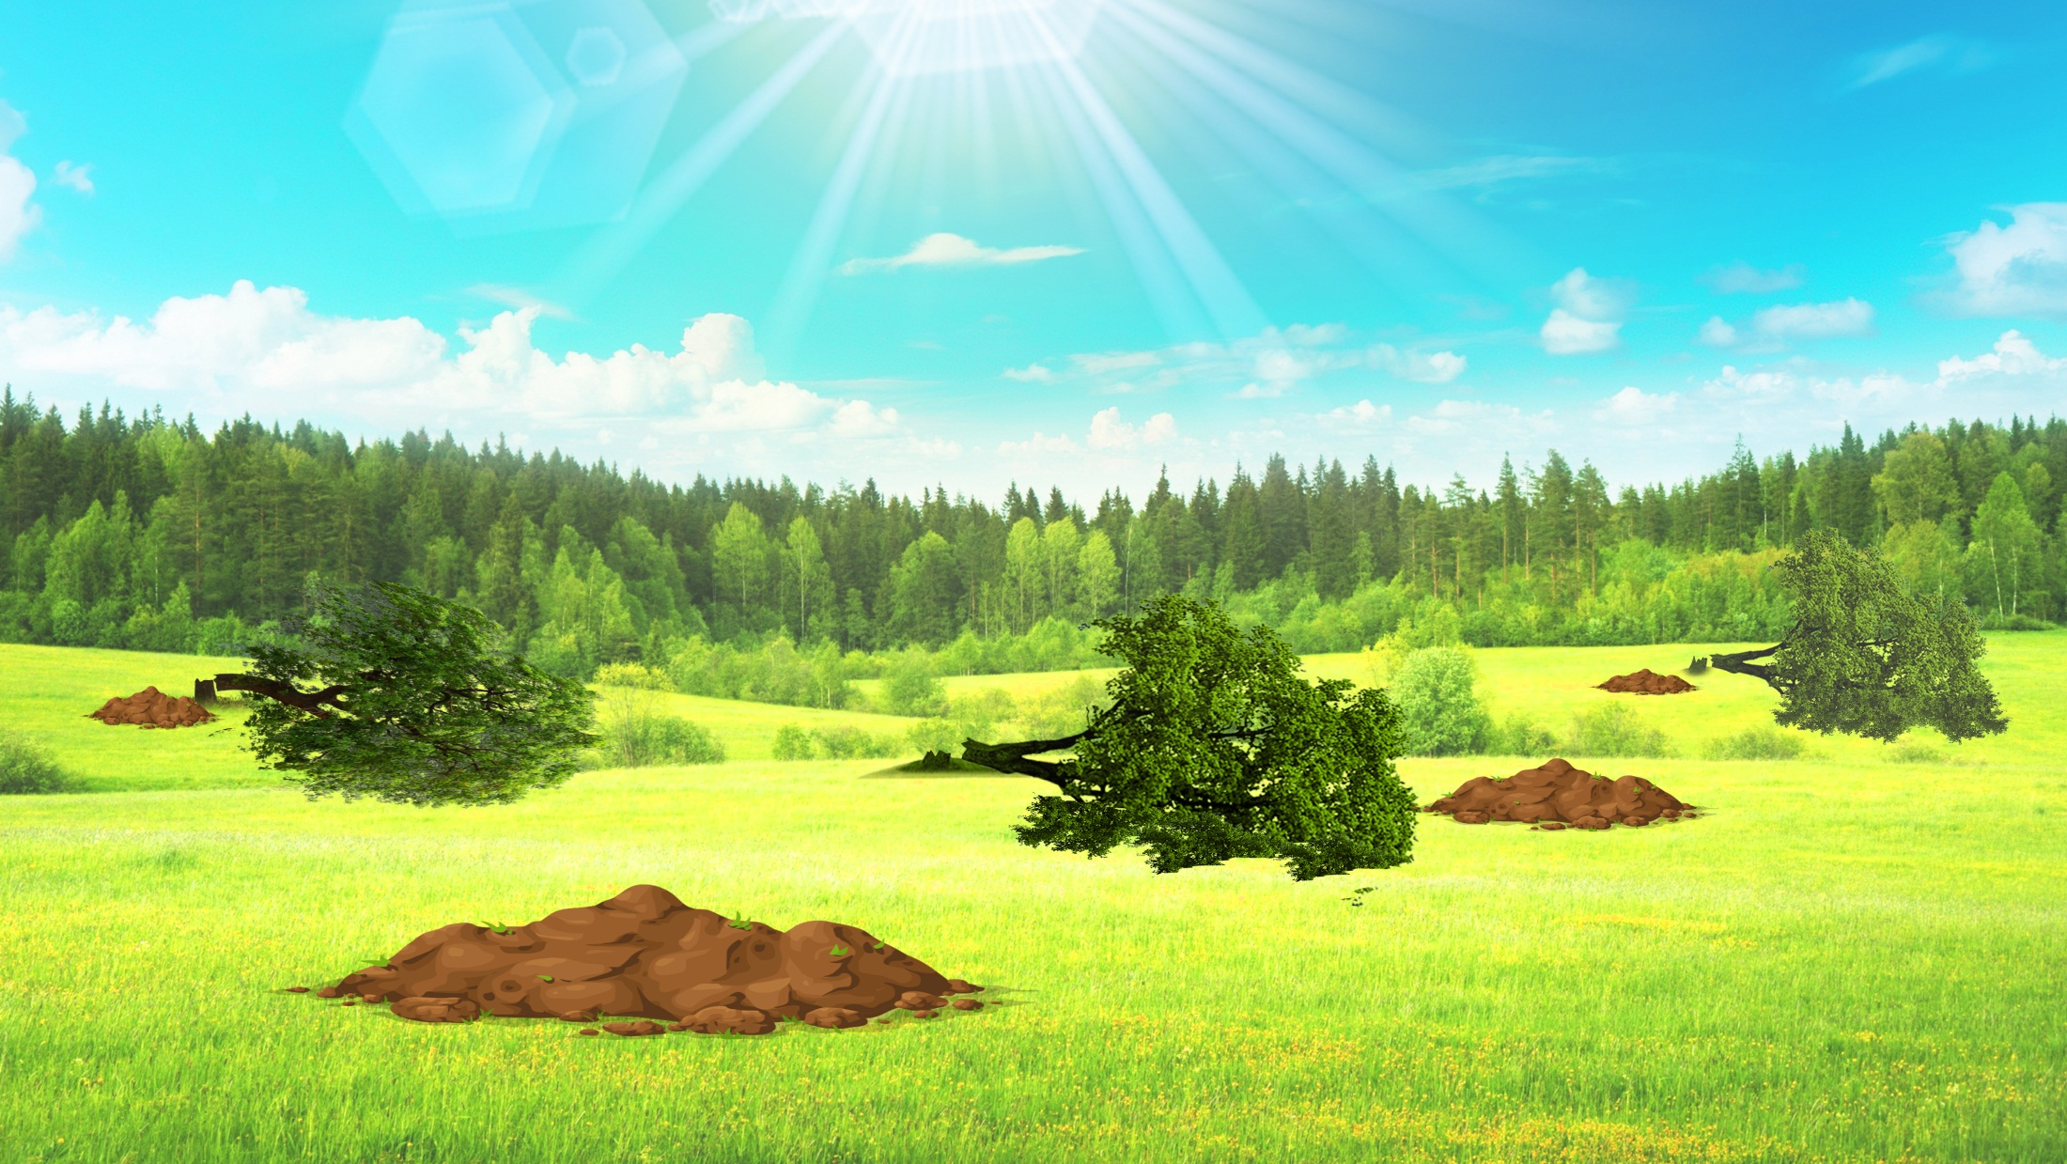

Slide 20
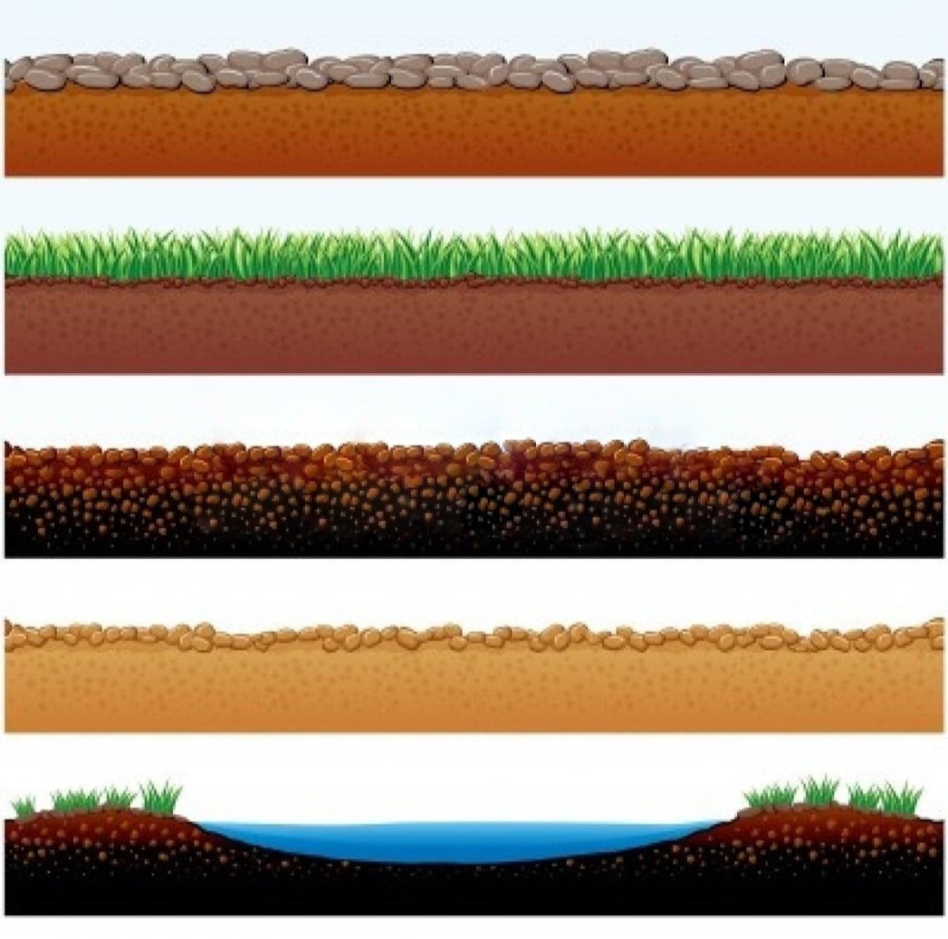
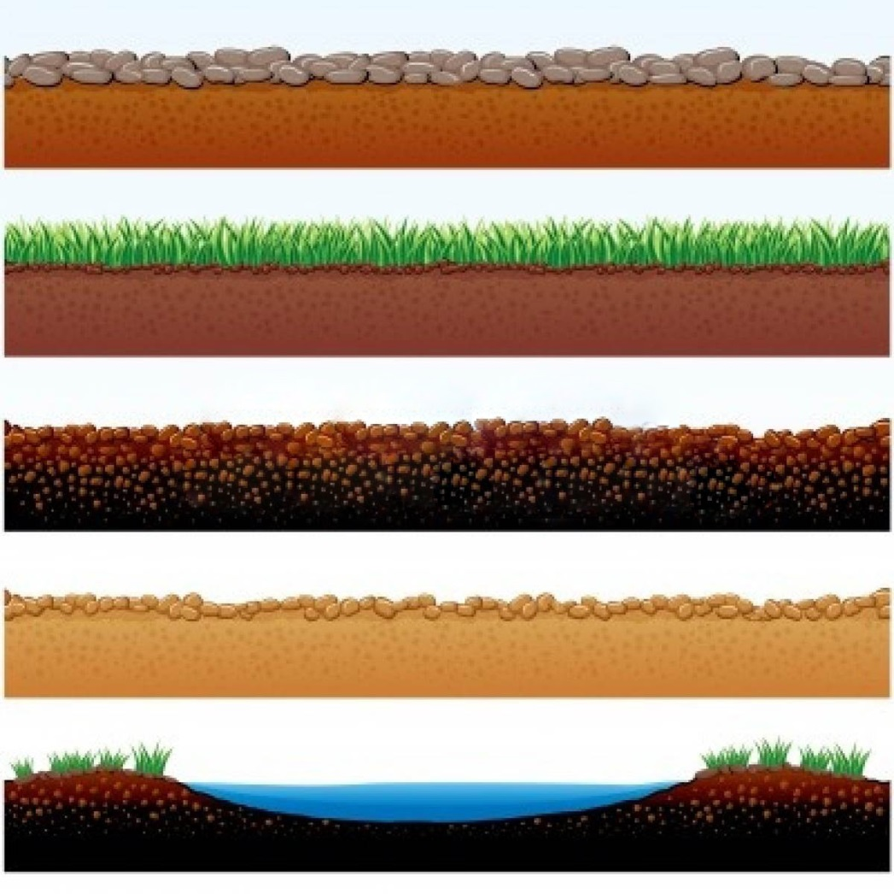

FOSSIL FUELS
Fuels obtained from the remains of plants and animals is called as FOSSIL FUELS
Remains of Plants and Animals
Under tremendous pressure and heat, they get converted into FUELS
FOSSIL FUEL

Slide 21
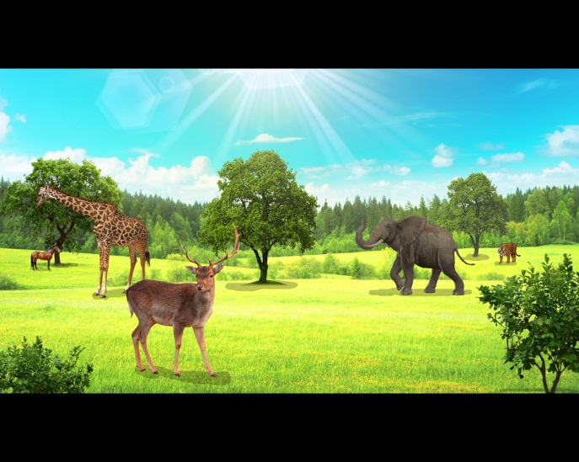
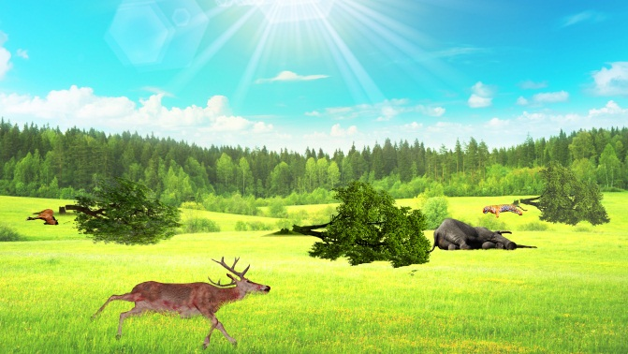
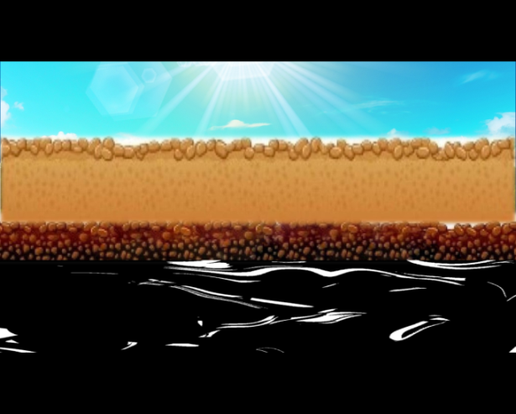
Deposits of Fossil Fuels are limited
Lakhs of years ago, remnants of plants and animals got buried into the Earth
They were converted into Fossil Fuels due to tremendous pressure of the Earth’s layer and the Heat inside.
As this process does not take place in a short time, the deposits of fossil fuels are limited.
Energy cycle

Slide 22
Non-renewable or
Conventional sources of energy
The sources of energy which have accumulated in nature over a very long period and cannot be quickly replaced when exhausted, are called the non-renewable or conventional.
They are formed by the decomposition of the remains of plants and animals buried under the earth, millions of years ago.

Slide 23
HARMFUL EFFECTS OF
BURNING FOSSIL FUELS
1
POLLUTION

Slide 24
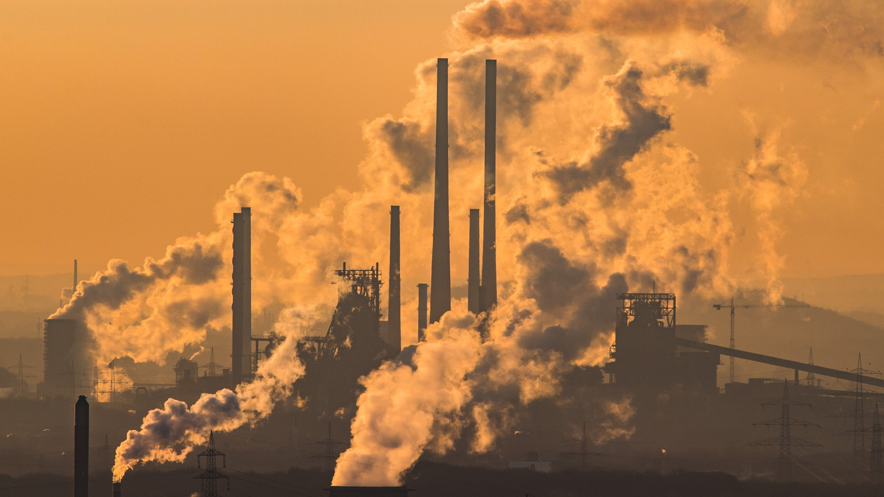
Companies release smoke causing AIR POLLUTION

Slide 25
HARMFUL EFFECTS OF
BURNING FOSSIL FUELS
1
POLLUTION
2
GLOBAL WARMING

Slide 26


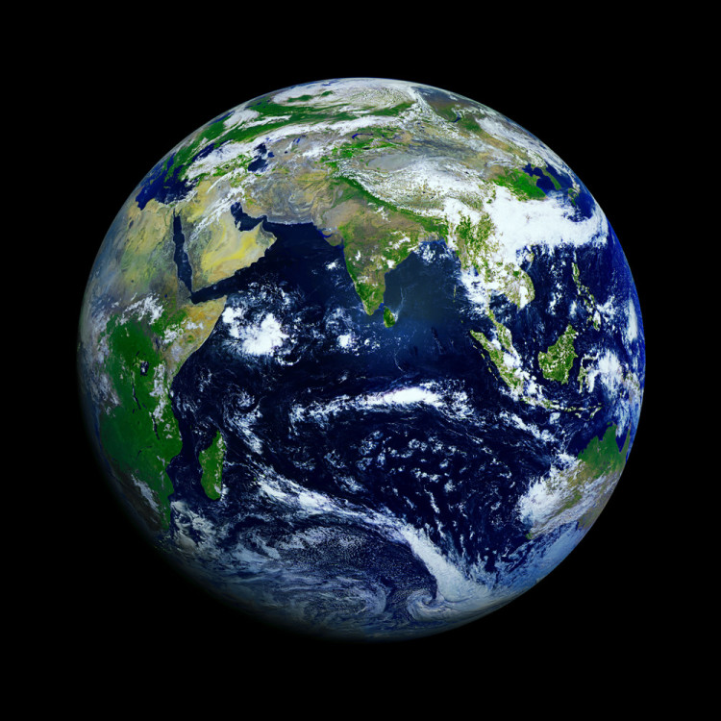
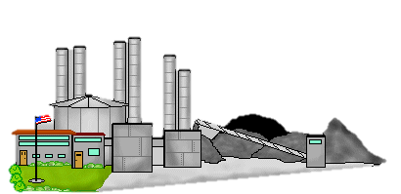

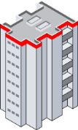


Slide 27
HARMFUL EFFECTS OF
BURNING FOSSIL FUELS
1
POLLUTION
4
ACID RAIN
2
GLOBAL WARMING
3
HOLE IN THE OZONE LAYER

Slide 28
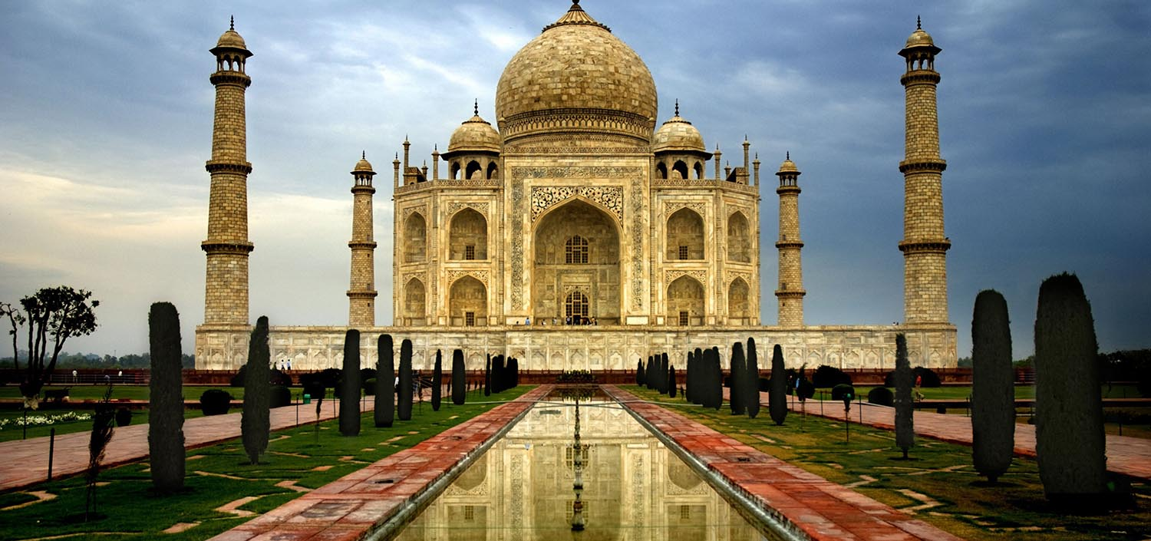


Slide 29
HARMFUL EFFECTS OF
BURNING FOSSIL FUELS
1
POLLUTION
4
ACID RAIN
2
GLOBAL WARMING
5
Destruction of Diversity
3
HOLE IN THE OZONE LAYER

Slide 30
Q.
What are the disadvantages of fossil fuels?
Q.
Why are we looking at alternate sources of energy?
Ans:
Fossil fuels that are traditionally used as a source of energy everywhere are nonrenewable.
They are limited in amount and once exhausted, they won't be available again.
Thus, there is a need to look for alternate sources of energy.

Slide 31
Thank You

